Slide 1

Jason Lubrano
Thomas Alder
Erika Bailon
Sky Ruff
Cassidy Carpenter
Dennis Nguyen
Javier Ramirez
Chakrya Ros
Eden Crashers
Notes:
JASON - TEAM LEAD
THOMAS - TECH LEAD
ERIKA - SCRUM MASTER
CASSIDY - DOCUMENTATION
CHAKRYA - TESTING
SKY - COMMUNICATION LEAD
JAVIER - REQUIREMENT CAPTURE
DENNIS - DESIGN LEAD

Slide 2
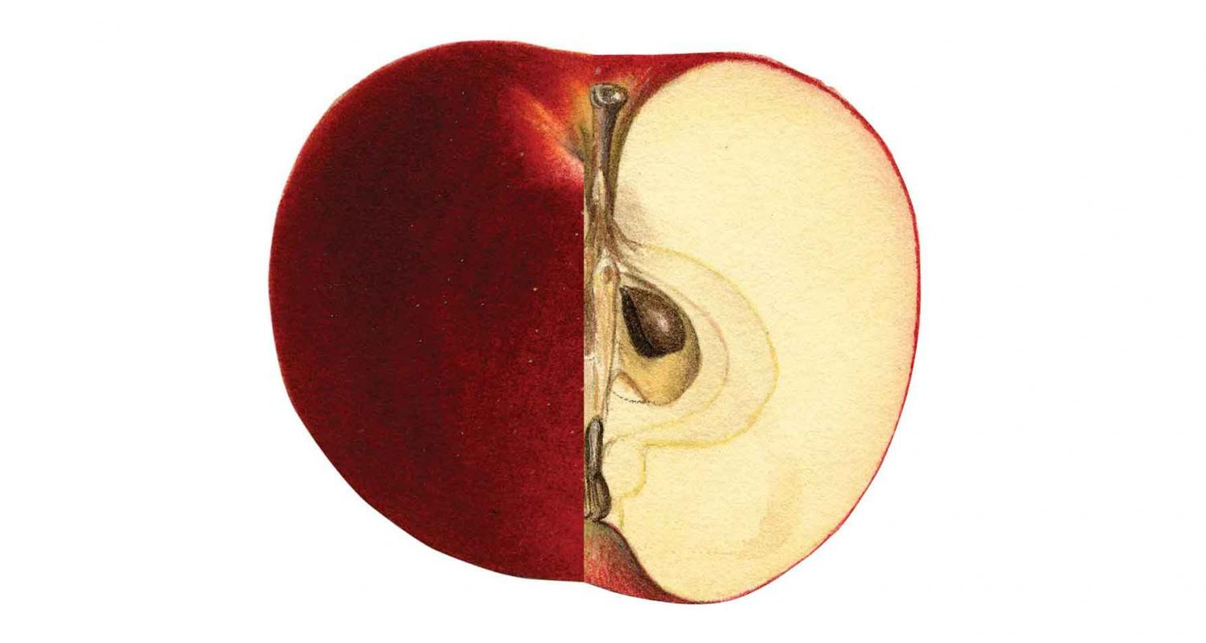
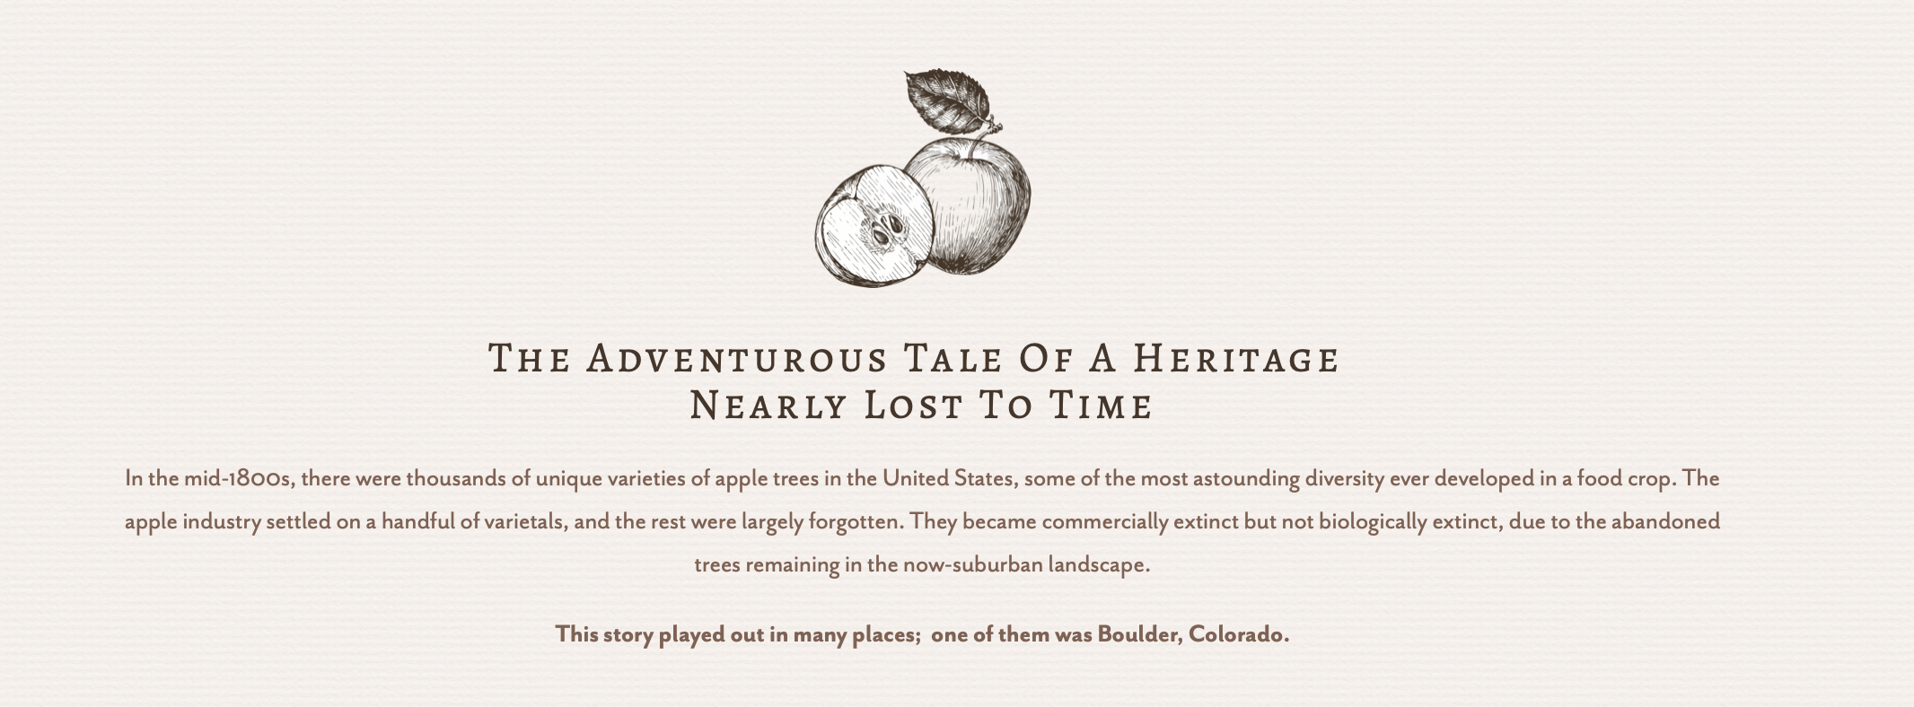
Sponsoring organization
CU Boulder EBIO Department and Boulder Apple Tree Project (BATP) dedicates their efforts to preserving and protecting the apple variety in Boulder, Colorado.
Notes:
JASON

Slide 3
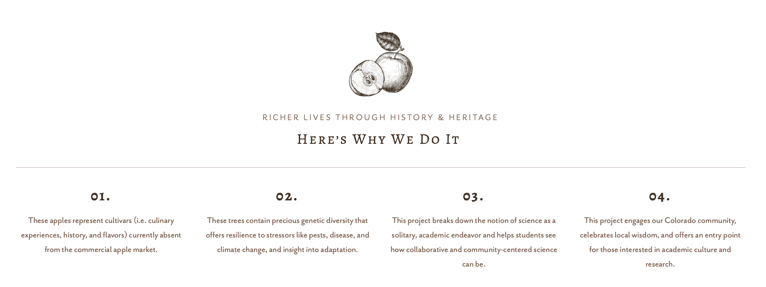
Notes:
CASSIDY

Slide 4
Mission
Our senior design team will work on a interactive user interface to share the data that is now owned by the Boulder Apple Tree Project.
Together, we can help promote appreciation and preservation of apples, their genetic families, and their connection to the history of Boulder.
Notes:
CHAKRYA

Slide 5

Boulder Apple Tree Project (BATP)
BATP is currently working on sharing a rich history with a vast knowledge of apples to people all around Colorado.
BATP consists of historians, ecologists, and more that continue research and development to help build a better understanding of Boulder’s apple trees.
Notes:
JAVIER

Slide 6
In Scope
Out of Scope
1. An interactive and engaging map as the principle produce.
2. Information about apple trees displayed on map.
3. Location of apple trees should be not be exact in order not to compromise the tree’s safety and respect the privacy of people whose property in which a tree may be growing.
4. Allows for expansion of the apple tree database.
5. The app should be scalable to be deployed online and in museums.
6. The web page and app should be compatible with mobile displays.
1. Developing a mobile application for iOS, Android, or any other mobile application platform.
2. User credentials for log-in or authorization of specific capabilities.
Notes:
ERIKA

Slide 7

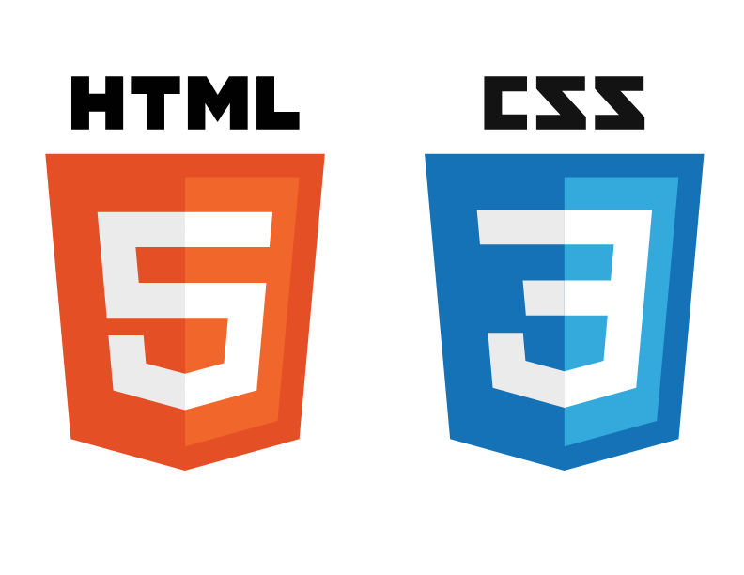






Technologies and Methods
Django (Backend)
Angular (Frontend)
AWS (Hosting)
HTML/CSS (Frontend)
+
PostgreSQL + PostGIS (Database)
Leaflet (Mapping)
Notes:
THOMAS
AWS: host website, store data, and manage databases

Slide 8

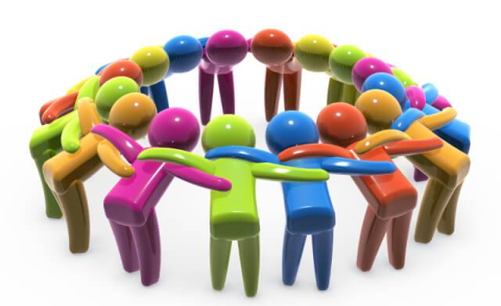


Communication
Slack
Weekly team meetings
Shared Documents and Google Drive
Monthly demos with Sponsor
Notes:
SKY

Slide 9
Risks / Mitigation Plan
- Technical complexity
- Conflict of requirements
- Budget constraints
Notes:
DENNIS

Slide 10

QUESTIONS?
THANK
YOU
How’d you like them apples?
Notes:
JASON - nooooooooooooo

